Slide 1
Multithreading and Concurrency

Slide 2

Single threading vs. multithreading
Threading foundation types Thread pools
Overview
Concurrency issues
Coordinating method access Manual thread synchronization
Concurrency related types & packages

Slide 3


Threading and Concurrency Coverage
New to threading Provide the building blocks you
need to begin building your understanding of threading and concurrency
Experienced with threading
Provide the necessary understanding of Java threading and concurrency to enable you apply your existing knowledge in Java

Slide 4
Process
Instance of a program/application
Has resources such as memory, etc.
Has at least one thread
A Quick Look at
the Basics
Thread
Sequence of programmed instructions
The thing that executes a program’s code
Utilizes process resources

Slide 5
Single Threaded Process
Process
Thread 0
(a.k.a. Main Thread)
Memory
Time

Slide 6
Multithreading
Process
Thread 0 |  | (a.k.a. Main Thread)
 |  | Thread 1
Memory
Thread 2
Thread 3
Time

Slide 7
Concurrency
Process
Thread 0
(a.k.a. Main Thread)
Memory
Thread 1
Thread 2
Thread 3
Time

Slide 8
Can enable more complete CPU use
Threads often wait on non-CPU tasks
Interacting with storage, networks, etc.
Most computers have multiple CPU cores
Allows things to run in parallel
Why does any of this matter?
Can reduce perceived execution times
Less wall-clock time passes
The Case for Multithreading

Slide 9
A Simple Adder Class
class Adder {
private String inFile, outFile;
public Adder(String inFile, String outFile) { /* assign filenames to member fields */ }
public void doAdd() int total = 0; String line = null;
throws IOException {
try (BufferedReader reader = Files.newBufferedReader(Paths.get(inFile))) { while ((line = reader.readLine()) != null)
total += Integer.parseInt(inline);
}
try (BufferedWriter writer = Files.newBufferedWriter(Paths.get(outFile))) { writer.write(“Total: " + total);
}
}
}

Slide 10
Using Simple Adder Class
String[] inFiles = {“./file1.txt”, . . . “./file6.txt”};
String[] outFiles = {“./file1.out.txt”, . . . “./file6.out.txt”};
try {
for(int i=0; i < inFiles.length; i++) {
Adder adder = new Adder(inFiles[i], outFiles[i]); adder.doAdd();
}
} catch(IOException e) {
// do something
}

Slide 11

Processing on a Single Thread
Startup work
Cleanup work
Process
file1.txt
file6.txt
Memory
file2.txt
Time

Slide 12

Processing on Multiple Threads
Startup work
Process
Cleanup work
ry
o
m
file1.txt
Me
file2.txt
file6.txt
Time

Slide 13
Multithreading is an explicit choice
Must break the problem into parts
Must handoff the parts for processing
The Move to Multithreading
Java provides differing levels of abstraction
Supports very direct handling
Manual creation & coordination
Supports higher level handling
Simplified creation & coordination

Slide 14
Limited threading abstraction
Very close to the standard OS behavior
Each thread started for a specific task
Terminates at end of task
Requires explicit management
Responsible to manage coordination
Exceptions tied to thread
Each thread must handle own exceptions
Java Threading Foundation

Slide 15
Runnable interface
Represents a task to be run on a thread
Only member is the run method
Threading Foundation
Types
Thread class
Represents a thread of execution
Can interact with and effect thread state
Begin execution with start method

Slide 16
Adder with Threading Support
class Adder {implements Runnable { private String inFile, outFile;
public Adder(String inFile, String outFile) { . . . }
public void doAdd() throws IOException { . . . } public void run() {
try {
doAdd();
} catch(IOException e) { . . . }
}
}

Slide 17
Running Adder on Separate Threads
String[] inFiles = {“./file1.txt”, . . . “./file6.txt”};
String[] outFiles = {“./file1.out.txt”, . . . “./file6.out.txt”};
try {
for(int i=0; i < inFiles.length; i++) {
Adder adder = new Adder(inFiles[i], outFiles[i]); adder.doAdd();
}
} catch(IOException e) {
// do something
}

Slide 18
Running Adder on Separate Threads
String[] inFiles = {“./file1.txt”, . . . “./file6.txt”};
String[] outFiles = {“./file1.out.txt”, . . . “./file6.out.txt”};
try {
for(int i=0; i < inFiles.length; i++) {
Adder adder = new Adder(inFiles[i], outFiles[i]); Thread thread = new Thread(adder); thread.start();
}
} catch(IOException e) {
// do something
}

Slide 19
Processing on Multiple Threads
Main thread terminates
Process
Memory

Slide 20
Processing on Multiple Threads
Main thread
waits for other threads
Process
Memory

Slide 21
Running Adder on Separate Threads
String[] inFiles = {“./file1.txt”, . . . “./file6.txt”};
String[] outFiles = {“./file1.out.txt”, . . . “./file6.out.txt”};
Thread[] threads = new Thread[inFiles.length]; for(int i=0; i < inFiles.length; i++) {
Adder adder = new Adder(inFiles[i], outFiles[i]); Thread thread = new Thread(adder); thread.start();
}

Slide 22
Running Adder on Separate Threads
String[] inFiles = {“./file1.txt”, . . . “./file6.txt”};
String[] outFiles = {“./file1.out.txt”, . . . “./file6.out.txt”};
Thread[] threads = new Thread[inFiles.length]; for(int i=0; i < inFiles.length; i++) {
Adder adder = new Adder(inFiles[i], outFiles[i]); threads[i] = new Thread(adder); threads[i].start();
}
for(Thread thread:threads)
thread.join(); // Blocks waiting for thread completion

Slide 23
Value of the Thread class
- Allows direct control over thread startup, shutdown, & coordination
Thread Management
Details
Challenge of the Thread class
Responsible to efficiently manage thread startup, shutdown & coordination
Easily misused

Slide 24
Abstracting
Thread Management with Thread
Java offers thread pools
Creates a queue for tasks
Assigns tasks into a pool of threads
Handles details of managing threads
Pools

Slide 25
ExecutorService interface
Models thread pool behavior
Can submit tasks
Request and wait for pool shutdown
Thread Pool
Types
Executors class
Methods for creating thread pools
Dynamically sized pools
Size limited pools
Pools that schedule tasks for later

Slide 26
Running Adder on Separate Threads
String[] inFiles = {“./file1.txt”, . . . “./file6.txt”};
String[] outFiles = {“./file1.out.txt”, . . . “./file6.out.txt”};
Thread[] threads = new Thread[inFiles.length]; for(int i=0; i < inFiles.length; i++) {
Adder adder = new Adder(inFiles[i], outFiles[i]); threads[i] = new Thread(adder); threads[i].start();
}
for(Thread thread:threads)
thread.join(); // Blocks waiting for thread completion

Slide 27
Running Adder in a Thread Pool
String[] inFiles = {“./file1.txt”, . . . “./file6.txt”};
String[] outFiles = {“./file1.out.txt”, . . . “./file6.out.txt”};
ExecutorService es = Executors.newFixedThreadPool(3); for(int i=0; i < inFiles.length; i++) {
Adder adder = new Adder(inFiles[i], outFiles[i]); es.submit(adder);
}
try {
es.shutdown();
es.awaitTermination(60, TimeUnit.SECONDS);
} catch(Exception e) { . . . }

Slide 28
Processing in a Thread Pool
awaitTermination
Process
file1.txt
file2.txt
file3.txt
file4.txt
file5.txt
file6.txt
ExecutorService

Slide 29
Creating a
Closer Relationship Between Thread
Multithreading not always loosely coupled
Caller may need results from worker
May need to know if task succeeded
Tasks

Slide 30
Thread Result Manual Handling
Process
result
Memory
result

Slide 31
Thread Exception Manual Handling
Process
Exception Info
Memory
Exception

Slide 32
Thread Result Handling Desired
Process
Memory
result

Slide 33
Thread Exception Handling Desired
Process
Memory
Exception

Slide 34
Callable interface
Represents a task to be run on a thread
Can return results
Can throw exceptions
Only member is the call method
Threading Relationship
Types
Future interface
Represents results a thread task
Returned by ExecutorService.submit
The key method is get
Blocks until task completes
Returns Callable interface result
Throws Callable interface exception

Slide 35
Adder Method Returning a Value
public void doAdd() throws IOException int total = 0;
String line = null;
try (BufferedReader reader = Files.newBufferedReader(Paths.get(inFile))) { while ((line = reader.readLine()) != null)
total += Integer.parseInt(inline);
}
try (BufferedWriter writer = Files.newBufferedWriter(Paths.get(outFile))) { writer.write(“Total: " + total);
}
}

Slide 36
Adder Method Returning a Value
public int doAdd() throws IOException {
int total = 0;
String line = null;
try (BufferedReader reader = Files.newBufferedReader(Paths.get(inFile))) {
while ((line = reader.readLine()) != null)
total += Integer.parseInt(inline);
}
try (BufferedWriter writer = Files.newBufferedWriter(Paths.get(outFile))) { writer.write(“Total: " + total);
}
}
doAdd

Slide 37
Adder Method Returning a Value
public int doAdd() throws IOException int total = 0;
String line = null;
try (BufferedReader reader = Files.newBufferedReader(Paths.get(inFile))) { while ((line = reader.readLine()) != null)
total += Integer.parseInt(inline);
}
return total;
}
doAdd

Slide 38
Adder Implementing Callable
class Adder implements private String inFile;
public Adder(String inFile) { . . . }
public int doAdd() throws IOException { . . . }
Runnable {
public void
try {
run() {
doAdd();
} catch(IOException e) { . . . }
}
}

Slide 39
Adder Implementing Callable
class Adder implements private String inFile;
Callable <Integer> {
public Adder(String inFile) { . . . }
public int doAdd() throws IOException { . . . }
public
Integer call() throws IOException {
return doAdd();
}
}

Slide 40
Start Adder Processing
String[] inFiles = {“./file1.txt”, . . . “./file6.txt”};
ExecutorService es = Executors.newFixedThreadPool(3);
for(int i=0; i < inFiles.length; i++) { Adder adder = new Adder(inFiles[i]);
es.submit(adder);
}

Slide 41
Start Adder Processing
String[] inFiles = {“./file1.txt”, . . . “./file6.txt”};
ExecutorService es = Executors.newFixedThreadPool(3); Future<Integer>[] results = new Future[inFiles.length]; for(int i=0; i < inFiles.length; i++) {
Adder adder = new Adder(inFiles[i]);
results[i]
= es.submit(adder);
}

Slide 42
Retrieving Adder Class Results
for(Future<Integer> result:results) {
try {
int value = result.get(); // blocks until return value available System.out.println(“Total: “ + value);
} catch(ExecutionException e) { // Exception raised in Adder Throwable adderEx = e.getCause(); // Get the Adder exception
// Do something with adderEx
} catch(Exception e) { . . . } // Non-Adder exceptions
}
es.shutdown();

Slide 43
The challenge of concurrency
Threads sometimes share resources
No problem if resources only read
Changes must be coordinated
Concurrency
Issues
Failure to coordinate can create problems
Receive wrong results
Crash the program

Slide 44
A Simple Bank Account Class
public class BankAccount { private int balance;
public BankAccount(int startBalance) { balance = startBalance;
}
public int getBalance() { return balance;
}
public void deposit(int amount) { balance += amount;
}
}

Slide 45
A Class to Update the Bank Account
public class Worker implements Runnable { private BankAccount account;
public Worker(BankAccount account) { this.account = account;
}
public void run() {
for(int i=0; i < 10; i++) {
int startBalance = account.getBalance(); account.deposit(10);
int endBalance = account.getBalance();
}
}
}

Slide 46
Running on a Single Thread
ExecutorService es = Executors.newFixedThreadPool(5); BankAccount account = new BankAccount(100);
End Balance: 110 StartBalance: 100
End Balance: 120 StartBalance: 110
End Balance: 130 StartBalance: 120
End Balance: 140 StartBalance: 130
End Balance: 150 StartBalance: 140
End Balance: 160 StartBalance: 150
End Balance: 170 StartBalance: 160
End Balance: 180 StartBalance: 170
End Balance: 190 StartBalance: 180
End Balance: 200 StartBalance: 190
Worker worker = new Worker(account); es.submit(worker);
// Shutdown es and wait

Slide 47
Running on Multiple Threads
ExecutorService es = Executors.newFixedThreadPool(5); BankAccount account = new BankAccount(100);
for(int i = 0; i < 5; i++) {
Worker worker = new Worker(account); es.submit(worker);
}
// Shutdown es and wait

Slide 49
What Happened on the 5 Threads
End Balance: 110 Start Balance: 100 Worker: 1
End Balance: 120 Start Balance: 110 Worker: 2
End Balance: 130 Start Balance: 120 Worker: 3
End Balance: 140 Start Balance: 130 Worker: 4
End Balance: 150 Start Balance: 140 Worker: 5
End Balance: 160 Start Balance: 150 Worker: 5
End Balance: 170 Start Balance: 160 Worker: 3
End Balance: 170 Start Balance: 160 Worker: 2
End Balance: 510 Start Balance: 500 Worker: 4
End Balance: 520 Start Balance: 510 Worker: 5
End Balance: 520 Start Balance: 510 Worker: 1
End Balance: 530 Start Balance: 520 Worker: 2
End Balance: 540 Start Balance: 530 Worker: 3
End Balance: 550 Start Balance: 540 Worker: 3

Slide 50
There’s More Than Meets the Eye
public class BankAccount { private int balance;
public BankAccount(int startBalance) { balance = startBalance;
}
public int getBalance() { return balance;
}
public void deposit(int amount) { balance += amount;
}
}
Read current value from memory
Perform addition
Write result back to memory

Slide 51
Unprotected Concurrency
Process
Thread 0 (a.k.a. Main Thread)
account
Thread 1
510
balance
520
510
520
520
510
Thread 5
Time

Slide 52
Coordinated Concurrency
Process
Thread 0 (a.k.a. Main Thread)
account
Thread 1
510
balance
520
510
520
530
530
520
Thread 5
Time

Slide 53
Synchronized methods
Coordinate thread access to methods
Use synchronized method modifier
Class can have as many as needed
Synchronization managed per instance
No more than one thread can be in any synchronized method at a time
Coordinating Method Access

Slide 54
When to use synchronized
Protect modification by multiple threads
Reading value that might be modified by another thread
Using Synchronized
Methods
Why not always synchronize methods
Has significant overhead
Use only in multithreading scenarios
Constructors are never synchronized
- A given object instance always created on exactly one thread

Slide 55
Synchronized Methods on Bank Account Class
public class BankAccount { private int balance;
public BankAccount(int startBalance) { balance = startBalance;
}
public synchronized int getBalance() { return balance;
}
public synchronized
void deposit(int amount) {
balance += amount;
}
}

Slide 56
5 Threads Running Correctly
100 +10 +10 +10 +10 +10 +10 +10 +10 +10 +10
+10 +10 +10 +10 +10 +10 +10 +10 +10 +10
+10 +10 +10 +10 +10 +10 +10 +10 +10 +10
+10 +10 +10 +10 +10 +10 +10 +10 +10 +10
+10 +10 +10 +10 +10 +10 +10 +10 +10 +10
= 600
5 Threads

Slide 57

Behavior of Synchronized Methods
Process
Thread 0 (a.k.a. Main Thread)
account
Thread 1
510
balance
510
520
520
530
530
520
Thread 5
Time

Slide 58
Synchronized methods
Automated concurrency management
Used lock of current object instance
All Java objects have a lock
Can manually acquire that lock
Use synchronized statement block
Available to any code with a reference
Manual Synchronization

Slide 59
Synchronized Method
class BankAccount { private int balance; // other members elided for clarity public synchronized void deposit(int amount) { balance += amount;
} } | clas pri | s Worker implements Runnable { vate BankAccount account ;
 | // other members elided for clarity public void run() { for(int i=0; i<10; i++) { a.dcecpoousnit(10); } } }

Slide 60
Synchronized Statement Block
class BankAccount { private int balance; // other members elided for clarity
public void deposit(int amount) { balance += amount; } } | clas pri // pub |  |  | s Worker implements Runnable { vate BankAccount account other members elided for clarity lic void run() {
 | } | } | for(int i=0; i<10; i++) { synchronized(account ) { .daecpcoosuitn(1t 0); } }

Slide 61
Why Use Synchronized Statement
Blocks
Synchronized blocks provide flexibility
Enables use of non-thread safe classes
Can protect complex blocks of code
Sometimes synchronized methods just aren’t enough

Slide 62
Bank Account Class Revisited
public class BankAccount { private int balance;
public BankAccount(int startBalance) { balance = startBalance; }
public synchronized int getBalance() { return balance;
}
public synchronized void deposit(int amount) { balance += amount;
}
public synchronized void withdrawal(int amount) { balance -= amount;
}
}

Slide 63
Transaction Worker
public class TxWorker implements Runnable { protected BankAccount account;
protected char txType; // ‘w’ -> withdrawal, ‘d’ -> deposit protected int amt;
public TxWorker(BankAccount account, char txType, int amt) { . . . }
public void run() { if (txType == ‘w’)
account.withdrawal(amt); else if (txType == ‘d’) account.deposit(amt);
}
}

Slide 64
Dispatching Transactions
ExecutorService es = Executors.newFixedThreadPool(5); TxWorker[] workers = // Retrieve TxWorker instances
for(TxWorker worker:workers) es.submit(worker);
// Shutdown es and wait

Slide 65
Transaction Worker
public class TxWorker implements Runnable { protected BankAccount account;
protected char txType; // ‘w’ -> withdrawal, ‘d’ -> deposit protected int amt;
public TxWorker(BankAccount account, char txType, int amt) { . . . }
public void run() { if (txType == ‘w’)
account.withdrawal(amt); else if (txType == ‘d’) account.deposit(amt);
}
}

Slide 66
Transaction Promo Worker
public class TxPromoWorker extends TxWorker {
public TxPromoWorker(BankAccount account, char txType, int amt) { super(. . .) }
public void run() { if (txType == ‘w’)
account.withdrawal(amt);
else if (txType == ‘d’) { account.deposit(amt); if(account.getBalance() > 500) {
int bonus = (int)((account.getBalance() – 500) * 0.1); account.deposit(bonus);
}
}
}
}

Slide 67
Dispatching Transactions
ExecutorService es = Executors.newFixedThreadPool(5); TxWorker[] workers = // Retrieve TxPromoWorker instances
for(TxWorker worker:workers) es.submit(worker);
// Shutdown es and wait

Slide 68
Behavior of Synchronized Methods
Process
Thread 0 (a.k.a. Main Thread)
d | 150
deposit get get deposit
account
150
-20
balance
450
600
300
280
300
withdrawal
w | 300
Time

Slide 69
Thread Safe Transaction Promo Worker
public void run() { if (txType == ‘w’)
account.withdrawal(amt);
else if (txType == ‘d’) {
synchronized(account) { account.deposit(amt); if(account.getBalance() > 500) {
int bonus = (int)((account.getBalance() – 500) * 0.1); account.deposit(bonus);
}
}
}
}

Slide 70
Behavior of Synchronized Methods
Process
Thread 0 (a.k.a. Main Thread)
^{d | 150} deposit get get deposit
account
150
10
balance
450
600
synchronized
610
310
300
withdrawal
w | 300
Time

Slide 71
Concurrency and collections
Collections and Concurrency
Concurrency safe collection access
Blocking collections

Slide 72
Synchronized collection wrappers
Most collections are not thread safe
Can create thread safe wrapper
Use Collection class static methods
Concurrency Safe Collection
Access
synchronizedList
synchronizedMap
Etc.
Wrapper is a thread safe proxy
Actual work occurs in original object

Slide 73
Coordinating producers and consumers
One or more threads produce content
One or more other threads consume
Must wait for content if not available
Blocking Collections
Java provides blocking queues
Attempt to read blocks if empty
Wakes up when content available
Examples
LinkedBlockingQueue
PriorityBlockingQueue
Etc.

Slide 74
java.util.concurrent
Types for managing concurrency
Has much of what we’ve talked about
Semaphores
Coordinate access to multiple resources
Lots more
Java Provides
Still More
java.util.concurrent.atomic
Types providing atomic operations
set, get, getAndAdd, compareAndSet

Slide 75
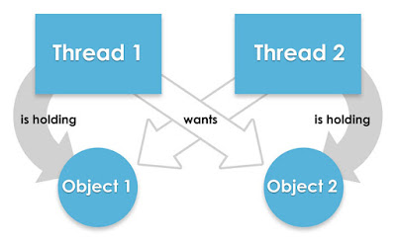
We cannot resolve deadlock but we can avoid deadlock situation based on several techniques.
Deadlock in java
- When two threads are waiting for each other forever means (i.e. it does not get a chance to enter in a ready queue) such type of infinite waiting is called deadlock.
- A deadlock occurs when the waiting process is still holding onto another resource that the first needs before it can finish.
- By using synchronized keyword we may move towards deadlock situation. Synchronize keyword is not recommended to apply unnecessarily.

Slide 76


Deadlock Example and Solution

Slide 77
We cannot resolve deadlock but we can avoid deadlock situation based on several techniques.
Avoid Dead Lock condition
- Avoid Nested Locks
- Avoid Unnecessary Locks
- Using thread join

Slide 78
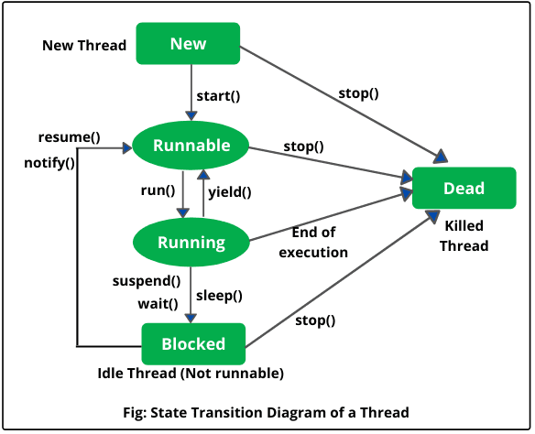
Thread States and Transitions

Slide 79
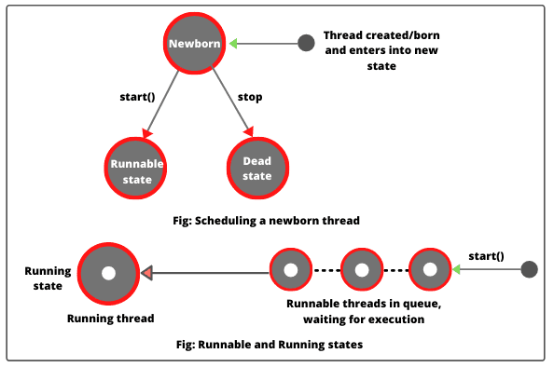
Runnable and Running States

Slide 80
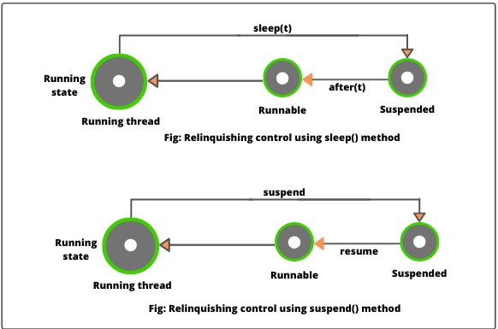
Relinquishing control using suspend method

Slide 81



Methods to prevent Thread Execution
yield()
join()
sleep()

Slide 82
Methods to prevent Thread Execution
- yield
- sleep

Slide 84
Set the priority for threads
- MIN_PRIORITY
- NORM_PRIORITY
- MAX_PRIORITY

Slide 85
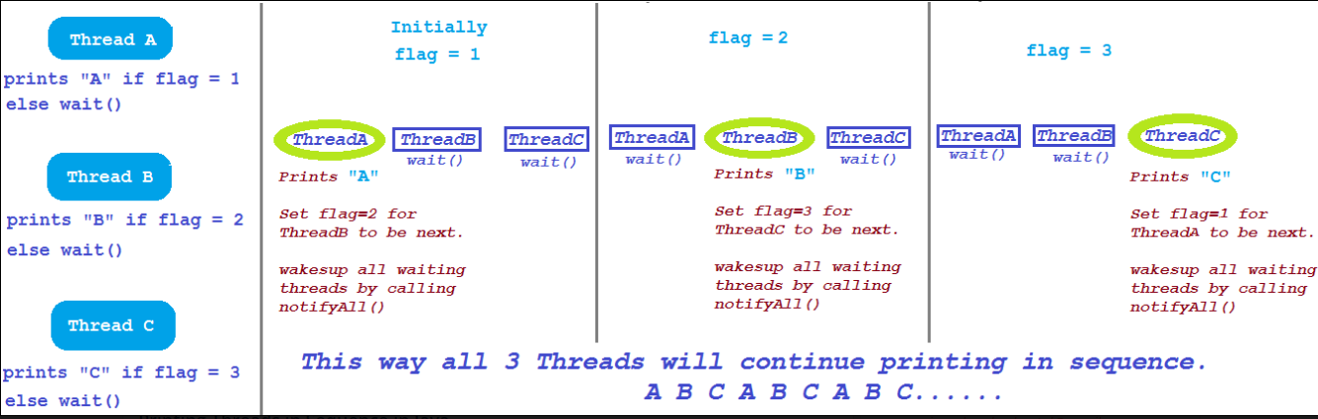
wait notify notifyall

Slide 86
Printing Threads in Sequence in Java using
- wait
- notify
- notifyall

Slide 87
Thread class
Represents a thread of execution
Similar to most OS thread representations
Responsible to handle most details
Summary
Runnable interface
Represents a task to run on a thread
Simply override run method
Can’t return results
Exceptions responsibility of thread

Slide 88
ExecutorService
Abstracts thread management details
Can interact with thread pools
Summary
Callable interface
Represents a task to be run on a thread
Can return results
Can throw exceptions
Future interface
Represents results of a thread task
Can access results from task
Can throw exceptions from thread task

Slide 89
All Java objects have a lock
Summary
Can access with synchronized methods
Acquires lock of target instance of call
Only one active at a time on an object
Can manually acquire lock
Use synchronized statement block
Available to any code referencing object

Slide 90
- Deadlock and how to avoid it
Summary
Thread States and Transitions
Methods to prevent Thread Execution
Thread Priorities
Using wait, notify and notifyall

